Slide 1
Relational Calculus

Slide 2
Another Theoretical QL-Relational Calculus
Comes in two flavors: Tuple relational calculus (TRC) and Domain relational calculus (DRC).
Calculus has variables, constants, comparison ops, logical connectives and quantifiers.
  TRC: Variables range over (i.e., get bound to) tuples.
    Like SQL.
  DRC: Variables range over domain elements (= field values).
    Like Query-By-Example (QBE)
  Both TRC and DRC are simple subsets of first-order logic.
    We’ll focus on TRC here
Expressions in the calculus are called formulas.
Answer tuple is an assignment of constants to variables that make the formula evaluate to true.

Slide 3
Tuple Relational Calculus
Query has the form: {T | p(T)}
  p(T) denotes a formula in which tuple variable T appears.
Answer is the set of all tuples T for which the formula p(T) evaluates to true.
Formula is recursively defined:
  start with simple atomic formulas
  (get tuples from relations or make comparisons of values)
  build bigger formulas using logical connectives.

Slide 4

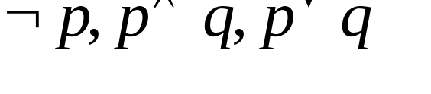


TRC Formulas
An Atomic formula is one of the following:
  R ∈ Rel
  R[a] op S[b] or R.a =S.b
  R[a] op constant where R[a] denotes attr.a of Rel R.
    Where op is one of
A formula can be:
  an atomic formula
  where p and q are formulas
  where variable R is a tuple variable
  where variable R is a tuple variable

Slide 5
Relational Calculus
DB
Is predicut true for ths tuple
(smith, A101, 1000)
Formula
F
Result
F (name, acct-no, Amt)
F (smith, A101, 1000)
If TRUE
i.e., in DB

Slide 6
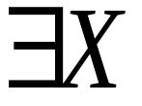
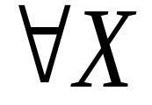
Free and Bound Variables
Quantifiers and in a formula are said to
bind X in the formula.
  A variable that is not bound is free.
Let us revisit the definition of a query:
  {T | p(T)}
Important restriction
  the variable T that appears to the left of `|’ must be the only free variable in the formula p(T).
  in other words, all other tuple variables must be bound using a quantifier.

Slide 7
Example Schema
Sailors (sid, sname, age, rating)
Boats (bid, color)
Reserves (sid, bid)

Slide 8
Selection and Projection
Find all sailors with rating above 7
  Modify this query to answer: Find sailors who are older than 18 or have a rating under 9, and are named ‘Bob’.
Find names and ages of sailors with rating above 7.
  Note: S is a tuple variable with 2 attributes (i.e. {S} is a projection of Sailors)
    only 2 attributes are ever mentioned and S is never used to range over any relations in the query.
{S | S ∈Sailors ∧ S[rating] > 7}
{S | ∃S1 ∈Sailors(S1[rating] > 7
∧ S[sname] = S1[sname]
∧ S[age] = S1[age])}

Slide 9
Joins
Find sailors and their rating for sailors rated > 7 who’ve reserved boat #103
  Note the use of ∃ to find a tuple in Reserves that `joins with’ the Sailors tuple under consideration.
{S | S∈Sailors ∧ S[rating] > 7 ∧
∃R∈Reserves
(R[sid] = S[sid] ∧ R[bid] = 103)}

Slide 10
Joins (continued)
Find sailors rated > 7 who’ve reserved a red boat
{S | S∈Sailors ∧ S[rating] > 7 ∧
∃R∈Reserves (R[sid] = S[sid]
∧ ∃B∈Boats (B[bid] = R[bid]
∧ B[color] = ‘red’))}
This may look cumbersome, but it’s not so different from SQL!

Slide 11
Division (makes more sense here???)
Find sailors who’ve reserved all boats
(hint, use ∀)
{S | S∈Sailors ∧
∀B∈Boats (∃R∈Reserves
(S[sid] = R[sid]
∧ B[bid] = R[bid]))}
Find all sailors S such that for all tuples B in Boats there is a tuple in Reserves showing that sailor S has reserved B.

Slide 12
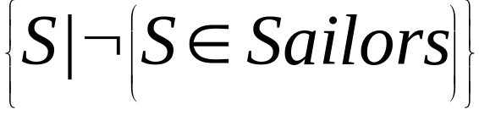
Unsafe Queries, Expressive Power
∃ syntactically correct calculus queries that have an infinite number of answers! Unsafe queries.
  e.g.,
  Solution???? Don’t do that!
Expressive Power (Theorem due to Codd):
  every query that can be expressed in relational algebra can be expressed as a safe query in DRC / TRC; the converse is also true.
Relational Completeness: Query language (e.g., SQL) can express every query that is expressible in relational algebra/calculus. (actually, SQL is more powerful, as we will see…)

Slide 13
Tuple Relational Calculus
Join Queries
Find the names of customers w/ loans at the Perry branch.
Answer has form {t | P(t)}.
Strategy for determining P(t):
1. What tables are involved?
  borrower (s), loan (u)
2. What are the conditions?
  (a) Projection: t [cname] = s [cname]
  (b) Join: s [lno] = u [lno]
  (c) Selection: u [bname] = “Perry”

Slide 14
Tuple Relational Calculus
Join Queries
Find the names of customers w/ loans at the Perry branch.
A. {t | ∃ s ∈ borrower (P(t,s))} such that:
P(t,s) ≡ t [cname] = s [cname] ∧ ∃ u ∈ loan (Q(t,s,u))
Q(t,s,u) ≡ s [lno] = u [lno] ∧ u [bname] = “Perry”
OR unfolded version (either is ok)
{t | ∃ s ∈ borrower (
t [cname] = s [cname] ∧
∃ u ∈ loan (s [lno] = u [lno] ∧ u [bname] = “Perry”))}

